Slide 1
Microsoft Azure Developer Camp

Slide 2
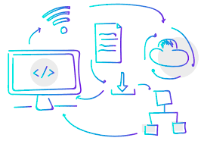
Digital Transformation

Slide 3
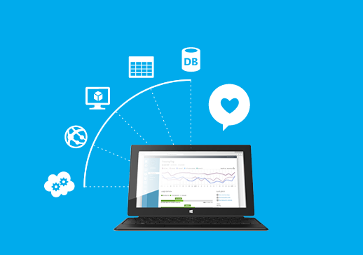

Digital Transformation
Digital transformation is not about replacing or refreshing your CRM or ERP…
It´s About Evolution
It´s About Transforming your business from the inside out, and being
Able to do so at scale.

Slide 4
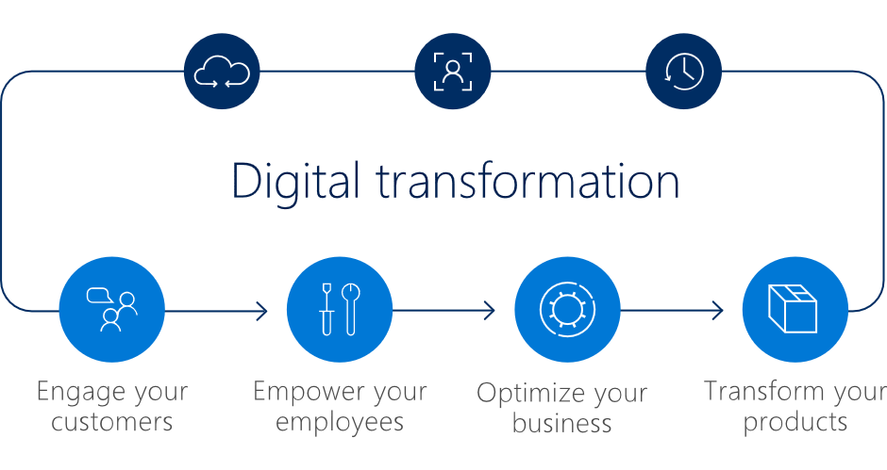
Digital Transformation
Digital transformation marks a radical rethinking of how an organization uses technology, people and processes to radically change business performance.
Notes:
Engage your customers
Foster collaboration, fuel productivity and maximize mobility to attract and retain top talent, while mitigating risks that come with providing freedom and space to employees.
Implementing a digital culture means maintaining a forward-thinking vision and empowering your team with the best tools to simplify collaboration and improve productivity.
Empower your employees
Build better, stronger engagements by harnessing data representing a 360-degree view of your customer, then drawing actionable intelligence and predictive insights that can deliver personalization at every touchpoint.
Optimize your business
Optimize operations to reshape customer relationships and service models by gathering data across a wide, dispersed set of endpoints, and drawing insight through advanced analytics that can be used to introduce improvements on a continuous, real-time basis.
SaaS (Software as a Service) and consumption-based models for modern infrastructures are now more conventional (and wiser) ways of buying technology.
Transform your products To keep up with these digital-first companies, businesses need to adapt not only their technology but also their existing business models and offerings, finding ways to differentiate with new products and services.
Without the right technology foundation and agility to evolve as business needs change, it will become increasingly difficult to meet new demands and retain customers in a competitive market.
This four-pillar approach is proven to support small, medium and large enterprises in their digital transformation.
First, find the best team of experts to help build your roadmap and identify key priorities. You don’t need to tackle everything at once.
Then, ensure you invest in a modern technology framework as your foundation that enables agility and growth.
With these key pieces in place, your digital transformation journey will naturally start exactly where you are now and evolve as your business needs change.

Slide 5
Digital Transformation A Necessary Disruption
Contemplating the concept of digital transformation has become an agonizing feat for CIOs, many of whom view it as a catchphrase that has become confusing at best and meaningless at worst.
So mainstream, in fact, that 40 percent of all technology spending will go toward digital transformations, with enterprises spending in excess of $2 trillion by 2019, according to IDC.
Notes:
CIO (Chief Information Officer)
Much of the blame lies with vendors who have abused the term when marketing solutions designed to satisfy every IT leader’s requirements. Savvy CIOs will tell you: Digital transformation doesn’t come in a box — or a cloud.

Slide 6
Digital Transformation Defined
Digital transformation marks a radical rethinking of how an organization uses technology, people and processes to radically change business performance.
Digital transformation, which should be led by the CEO, requires cross-departmental collaboration in pairing business-focused philosophies with rapid application development models.

Slide 7
App Modernization
SaaS apps
Serverless
Replace
Microservices
Rebuild New
Containers
Rearchitect
VMs
Refactor
Existing on-premises applications
Rehost
Migration strategies
Notes:
Rehost
Often referred to as a "lift-and-shift" migration. This option doesn't require code changes, and let's you migrate your existing apps to Azure quickly. Each app is migrated as is, to reap the benefits of the cloud, without the risk and cost associated with code changes.
Refactor
Often referred to as “repackaging,” refactoring requires minimal changes to apps, so that they can connect to Azure PaaS, and use cloud offerings. I.E. You could migrate existing apps to Azure App Service or Azure Kubernetes Service known as AKS
Or, you could refactor relational and non-relational databases into options such as Azure SQL Database Managed Instance, Azure Database for MySQL, Azure Database for PostgreSQL, and Azure Cosmos DB
Rearchitect
Rearchitecting for migration focuses on modifying and extending app functionality and the code base to optimize the app architecture for cloud scalability.
For example, you could break down a monolithic application into a group of microservices that work together and scale easily
Or, you could rearchitect relational and non-relational databases to a fully managed DBaaS solutions, such as Azure SQL Database Managed Instance, Azure Database for MySQL, Azure Database for PostgreSQL, and Azure Cosmos DB
Rebuild
Rebuild takes things a step further by rebuilding an app from scratch using Azure cloud technologies
For example, you could build green field apps with cloud-native technologies like Azure Functions, Azure AI, Azure SQL Database Managed Instance, and Azure Cosmos DB

Slide 8
When do you need use this strategies?
Rehost
Refactor
Migrate
Rearchitect
Rebuild
Notes:
Rehost
When you need to move apps quickly to the cloud.
When you want to move an app without modifying it.
When your apps are architected so that they can leverage Azure IaaS scalability after migration.
When apps are important to your business, but you don't need immediate changes to app capabilities
Refactor
If your app can easily be repackaged to work in Azure
If you want to apply innovative DevOps practices provided by Azure, or you're thinking about DevOps using a container strategy for workloads
For refactoring, you need to think about the portability of your existing code base, and available development skills
Rearchitect
When your apps need major revisions to incorporate new capabilities, or to work effectively on a cloud platform
When you want to use existing application investments, meet scalability requirements, apply innovative Azure DevOps practices, and minimize use of virtual machines
Rebuild
When you want rapid development, and existing apps have limited functionality and lifespan
When you're ready to expedite business innovation (including DevOps practices provided by Azure), build new applications using cloud-native technologies, and take advantage of advancements in AI, Blockchain, and IoT

Slide 9
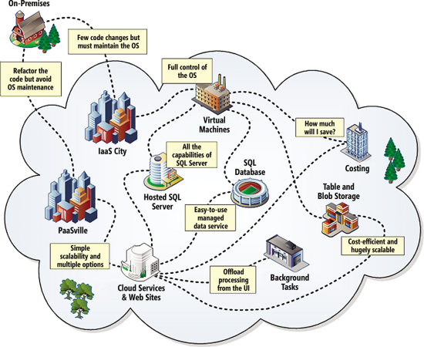
Existing on-premises applications migrating to Azure
Notes:
As you can see from the map, the initial decision when migrating to Azure is to choose which route to follow Infrastructure as a Service (IaaS) or Platform as a Service (PaaS).
As its name suggests, the IaaS approach provides the runtime infrastructure such as a virtual server and network connectivity for you to install the OS, services and applications of your choice. Effectively, you just pick up your server and run it in Microsoft datacenters. Azure offers a range of preinstalled OSes you can choose from (such as Windows Server and Linux), and you can still take advantage of peripheral services, such as authentication though Azure Active Directory, messaging with Azure storage queues or Service Bus, global routing to your application through Traffic Manager, and more.
Alternatively, you can have Microsoft manage the OS and runtime platform for you by adopting the PaaS approach. Azure Web Sites provides an easy-to-use hosting platform for Web applications and Web sites with simple management and deployment capabilities that can integrate directly with many source control systems and supports a range of programming languages. If you want more control over the platform, including the capability to run a mixture of different types of roles and directly integrate caching, you can choose the Cloud Services approach. This allows you to deploy separate Web and worker roles; provides a wider range of configuration options; and is well-suited to a versioned and staged deployment environment.

Slide 10
Value to Optimize and Modernize

Slide 11
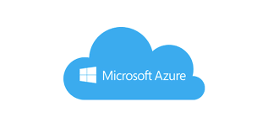
FROM: Amazing Because Cloud = ABC TO: Impossible Without Cloud = IWC
Notes:
Today, numerous technology trends are forcing IT to become more dynamic, relevant, and business-aware. These trends include mobile computing, agile development, digitally inclined consumers, and you probably guessed it, cloud computing

Slide 12
Digital Transformation Is Impossible Without the Cloud
The organizations that are willing to step up and face these trends are the ones experiencing transformation and growth, while those stuck in the traditional ways are beginning to stumble.
Notes:
Already, 80% see cloud as an integrated part of their digital transformation direction, and this is why.

Slide 13


Innovate or Risk Losing Everything
As agile start-up companies continue to disrupt the status quo of long-standing markets and industries, large enterprises are left with a troubling dilemma – innovate or die.

Slide 14

Cloud Maturity Model

Slide 15
Six Levels of Cloud Maturity
Experimenting: What is the cloud?
Securing the cloud: Can we trust the cloud?
Enabling servers and SaaS: Lift-and-shift, confirmation the cloud works pretty well
Enabling value added services: Dynamic cloud becomes a practice
Enabling unique services: Dynamic cloud is deeply ingrained in the culture
Mandating cloud usage: Why do we need our own data centres

Slide 16
Level 1: Experimenting With The Cloud
Level 1 involves using the cloud for a single, simple piece of an application to test how cloud services work. Often, the first service used is a storage solution such Azure Storage, because it’s easy to store some things in the cloud and avoid addressing the complex processes and servers an application relies on.
Notes:
(introduction)
This first, tentative step into the cloud relies on safe technologies—technologies that apply in simple ways to applications and parts of applications that are typically less mission critical.
(finally)
This level usually starts as a one-off experiment, where one or more teams conduct stand-alone migrations. No cloud policies are created at this point; instead it’s all about figuring out exactly what the cloud is.

Slide 17

Level 2: Securing The Cloud
Level 2 is a critical evolution point in an organization’s cloud culture, as it begins to involve disciplines throughout the company—legal, finance, security, and so on.
Notes:
This is when policies on how the cloud can be used within a company begin to be formed. The precise nature of these guidelines, from formal policies to ad-hoc “company culture” understandings, don’t matter that much. What’s important is that the entire company is involved and all stakeholders have input.

Slide 18
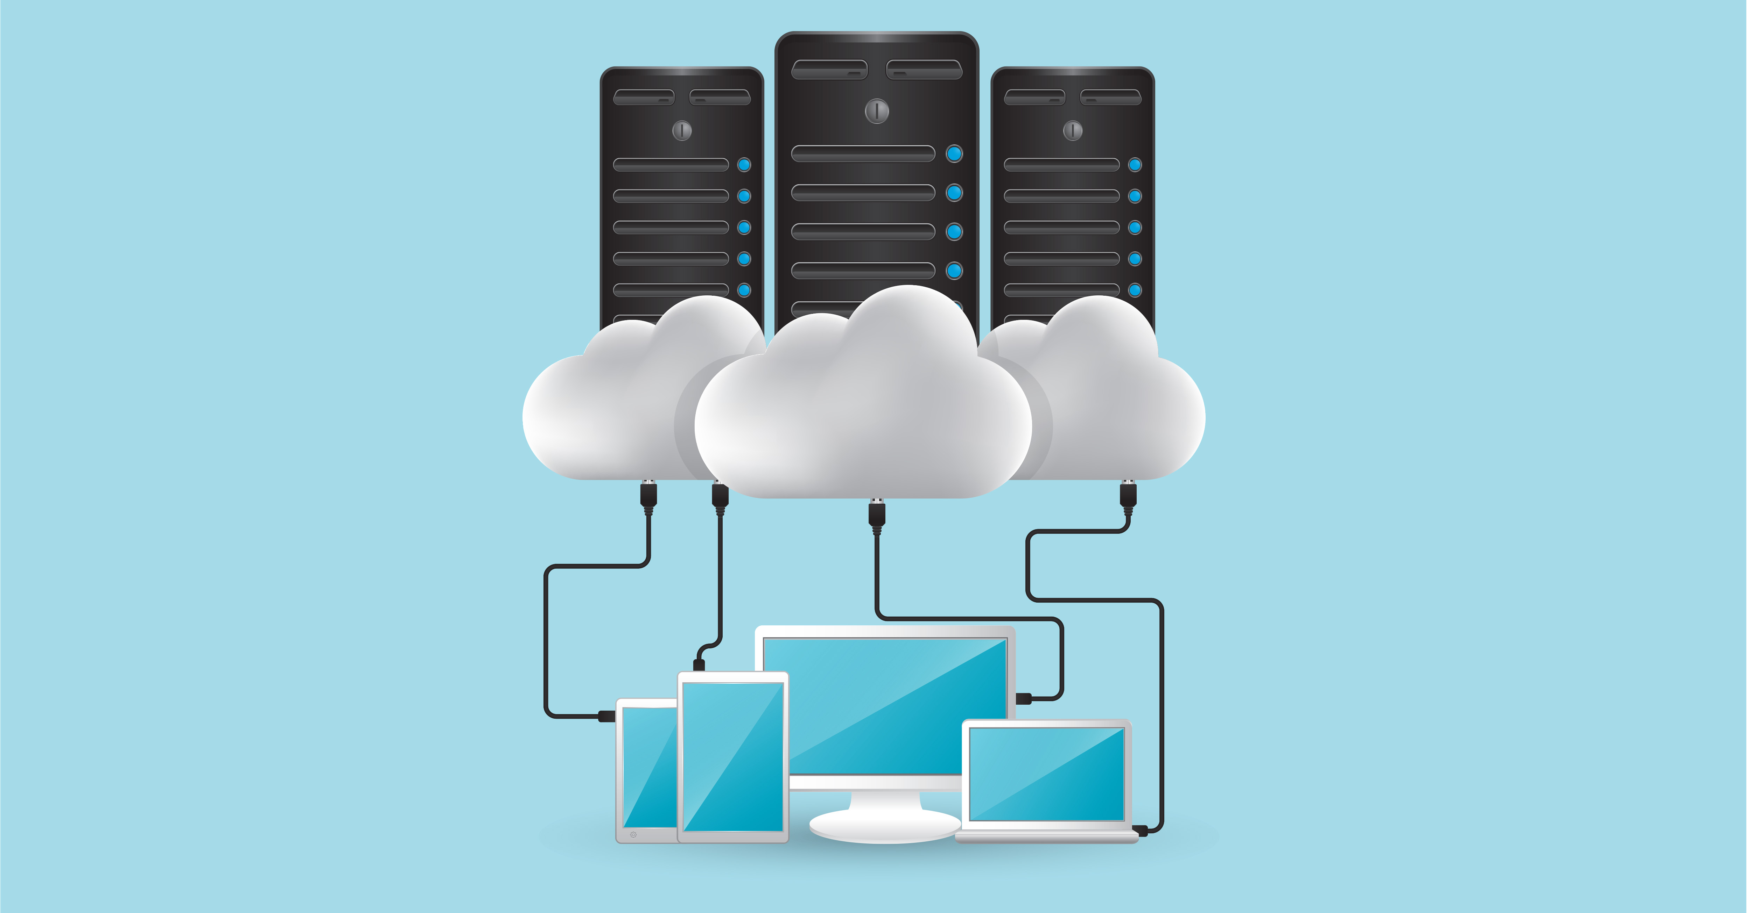
Level 3: Using Servers And Applications In The Cloud
The result of this level should be an understanding of how the cloud works from an entire application standpoint. Critically, this is the point at which the organization begins to enjoy actual advantages from using the cloud.
Level 3 is also when an organization’s application visibility and monitoring strategies being used in data centres get extended to the cloud. These monitoring and visibility strategies become a central component in making sure an application migration is successful.
Notes:
(introduction)
The third stage of cloud maturity comes when an organization begins to replace on-premise servers and other backend resources. These are still simple lift-and-shift applications, with a basic philosophy of “Let’s just move an application to the cloud and see what happens.”
Advantages: (in the sentence “the organization begins to enjoy actual advantages)
lowered costs, increased flexibility, etc.
FINALLY:
Be warned, however: Level 3 can be a danger point. If organizations attempt to evaluate the value of running applications in the cloud at this stage, they may find they’re bearing the costs of the cloud without enjoying the corresponding benefits. That can cause companies to give up and regard their entire cloud effort as a failure.

Slide 19

Level 4: Enabling Value-Added Managed Services
A typical Level 4 conversation might go like this: “Okay, now that I have a database in the cloud, I still have to manage that database, but AWS and Microsoft Azure and everyone else offers managed databases. Why don’t I let them manage the database for me?”
As the dynamic cloud starts taking effect here, the cloud’s biggest benefits kick in. This is also when companies commit to using the cloud for at least some of their strategic applications and services.
Notes:
(introduction)
Of course, the cloud is much more than just a place to host applications on servers outside of a company’s data centres. At Level 4, organizations begin to take advantage of some of the cloud’s value-added services.
(after the first paragraph)
This is when organizations take advantage of managed services in the cloud, including services like Amazon Relational Database Service (RDS) and Amazon Aurora. They may also look at services like Amazon Elastic Beanstalk and Amazon Elasticsearch Service to provide even higher value services to their applications.

Slide 20
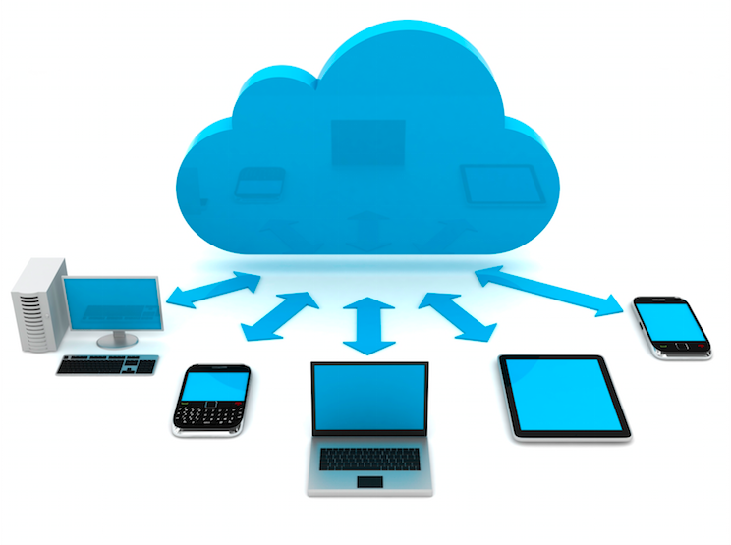
Level 5: Enabling Cloud-Unique Services
At Level 5, the concept of dynamic cloud becomes embedded in an organization’s application development and management processes. It is important at this time to make sure your monitoring strategy gives you the proper visibility you require into these highly dynamic applications.
Notes:
Once a company becomes a cloud-enabled organization, it can look to leverage high-value, cloud-specific services. Uniquely available in cloud-based environments, these services are designed for the dynamic cloud. They include serverless computing (such as AWS Lambda), highly scalable schema less databases (such as Amazon DynamoDB), data warehousing (Amazon Redshift), and other generalized services, such as queuing (Amazon Simple Queue Service, or SQS) and notification (Amazon Simple Notification Service, or SNS) services.

Slide 21

Level 6: Mandating The Cloud
At Level 6 new applications default to running in the cloud rather than running in a data centre, and the organization must justify why they would need to be in a data centre. The end goal, though, is to migrate all applications into the cloud so the organization can decommission its data centres.
Notes:
This is the ultimate maturity level of cloud adoption. When an organization reaches Level 6, the cloud is meeting most if not all of its data center needs, and also provides additional value-added services. This prompts many companies to ask the next obvious question: “Why do we need our own data centers? Why do we need to be in the business of running a data center at all?”

Slide 22
Cloud Computing

Slide 23
Cloud Computing
What is cloud computing?
It is the use of Remote servers o the internet to store, manage and process data rather than a local server or your personal computer.
The central idea of cloud is this:
INSTEAD OF BUYING OF COMPUTER…
You Buy Compute.
Notes:
Instead of sinking large amounts of capital into physical machinery which is hard to scale, breaks down mechanically, and rapidly becomes obsolete, you simply buy time on someone else’s computer, and let them take care of the scaling, maintenance, and upgrading.
The cloud is not just about remote, rented computing power. It is also about distributed systems.

Slide 24
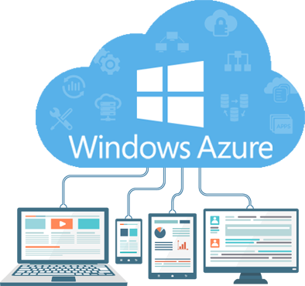
Characteristics of Cloud Computing

Slide 25
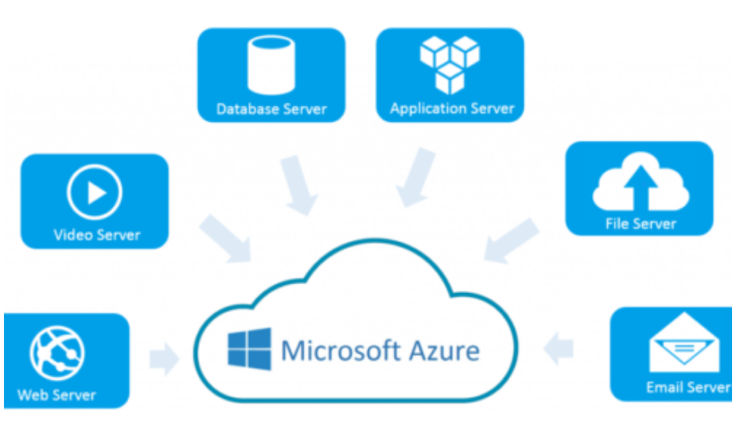
Essential Characteristics of Cloud Computing
On-demand self service
Broad network access
Resource pooling
Rapid elasticity
Measured Service
Notes:
On-demand self service
Users access computing services such as server time and network storage on demand, as needed without engaging human representatives of the server provider.
Broad network access
Users can access capabilities at different locations over the network through standard interfaces and devices such as workstations, laptops, tablets, and mobile phones.
Resource pooling
Computing resources are pooled to serve multiple customers using a multitenant model. Both physical and virtual resources are dynamically assigned and reassigned based on user demand. From a user perspective, resources are location independent and the user has no need to know or control the exact location of the provided computing resources.
Rapid elasticity
Computing resources are rapidly scaled (up or down) to meet user requirements. Users can appropriate different resources and services in any quantity, as needed at any time.
Measured Service
Resource use is controlled and optimized by a metering capability appropriate for each type of service, such as storage, bandwidth, processing, and active user accounts. This is usually on a pay-per-use or charge-per-use basis. Other options include subscription-based pricing models such as per hour, per day, per month, or all you can use up to a predetermined cap.

Slide 26
Cloud Computing Service Models
Cloud Clients
Web browsers, operating systems, mobile apps, client, devices: laptops, tablets, smartphones, etc.
Software as a service (SaaS)
Platform as a service (PaaS)
Infrastructure as a service (IaaS)
SaaS
On demand applications made available over the web. Examples: MS Office.
PaaS
OS, application execution environment, database, webservice, etc. Windows Azure
IaaS
Servers, virtual machines, network, storage, firewalls etc. Examples: Azure
Notes:
SaaS:
It allows companies to use software without purchasing them, which reduces the expenditure of the company drastically, since they are already installed on the cloud servers they can be quickly deployed and therefore saves time.
IaaS is an infrastructure provided by the cloud service vendor to create, run and manage VMs that run on the vendor’s infrastructure. Depending on the vendor, you can create a VM running Windows or Ubuntu or Linux and install anything you want on it. In IaaS, you don’t have control over the hardware or virtualization software, but you have control over the creation, running and management of VMs. So unlike PaaS, you are completely responsible for it.
For Example, Microsoft Azure provides the ability to set up virtual networks, load balancers, storage and many other services that run on its infrastructure.
PaaS:
It allows developers to build applications, collaborate on projects without having to purchase or maintain infrastructure.
PaaS is a platform provided by the cloud service vendor, where you can deploy your existing application. This makes the developers free from the infrastructure management and allow them to focus on development rather than environment.
For Example, Web Apps and Cloud Services offered by Microsoft Azure can be used to deploy your app without knowing the nuts and bolts of hosting environment.
IaaS:
It allows companies to rent servers, storage space, etc. from a cloud provider.
SaaS is software that is centrally hosted and managed for the end customer. So that all customers can access it. Even, it can be scaled out from one instance to multiple instances to provide the best performance in all locations. SaaS is usually provided by a monthly or annual subscription.
For Example, Microsoft Office 365, Dropbox, WordPress and Amazon Kindle etc.

Slide 27
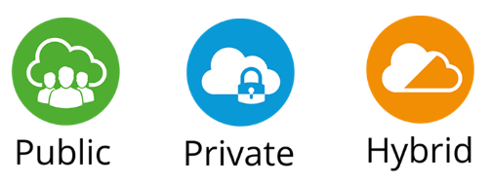
Cloud Deployment Models

Slide 28
Cloud Deployment Models
Notes:
Public Cloud
A public cloud is managed by the cloud vendor and all cloud resources run in cloud vendor datacenters. Public cloud resources like servers and storage are accessible over the Internet.
For Example, Microsoft Azure.,
Private Cloud
A private cloud is managed by a single business or organization and all cloud resources run in an organization on-site datacenter. A private cloud services are accessible through a private network.
For Example, Microsoft Azure resources running in an organization on-site datacenter
Hybrid Cloud
A hybrid cloud is a combination of public and private clouds. Some cloud resources run on public cloud vendor datacenters and some of them run in organization on-site datacenters. A hybrid cloud gives greater flexibility and more deployment options to a business.
For Example, Microsoft Azure some resources running in an organization on-site datacenters and some on Microsoft datacenters.

Slide 29
Why Should You Migrate Your IT Infrastructure to Azure

Slide 30
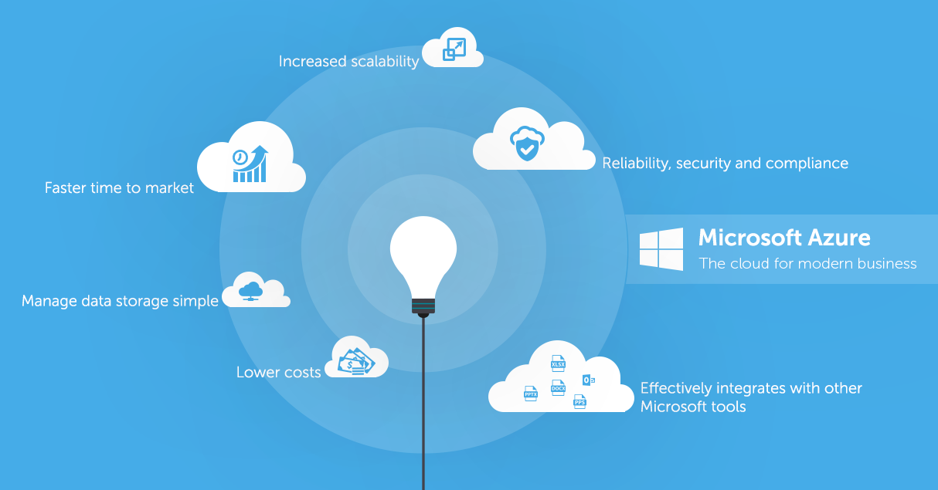
Advantages to migrate to Azure
Speed
Agility, Scalability, and Flexibility
Global Presence and Reach
Disaster Recovery
Integrated Development Environment
Security
Regulatory Compliance
Notes:
Speed
Windows is the most familiar platform for IT professionals. Therefore, they will find it intuitive to use Azure platform for deployment, operation, and scaling up their activities. It comes with a nearly flat learning curve for the IT professionals, which means that the cloud migration will be a smooth and hassle-free process for your business.
Agility, Scalability, and Flexibility
Business environment in every industry is unpredictable. Businesses need flexible infrastructure that helps them meet varying market demands, seasonal or otherwise. The Azure platform allows businesses to increase or decrease their scale of operations with ease to meet their changing needs and pay for only what they use. Azure even offers an autoscaling feature to help businesses automatically scale up or down, as per their demand.
Global Presence and Reach Microsoft has distributed Azure platform’s resources across the globe. The platform dynamically analyses the performance and offers services seamlessly, irrespective of their location. In other words, Azure helps businesses reach their customers worldwide by utilizing the right data centres that deliver the best performance, as per their location.
Disaster Recovery
multiple redundant data centres. By combining this with its other advanced capabilities, Azure is able to offer cutting-edge features such as rolling reboot capabilities, hot and cold standby models, and regional and global failover options. Armed with these, businesses can run all of their critical applications and data through redundant, failover sites until the recovery process is complete. This way, the end customers do not experience a downtime and businesses, small or large, do not face any risk of losing their clientele.
Integrated Development Environment
Azure’s cloud development tools are integrated into the Visual Studio environment. Therefore, developers who are familiar with the Visual Studio development environment can start developing applications for Azure right away. There is no learning curve involved in mastering a new platform here. As a result, it is easy to find qualified developers that are familiar with the platform too.
Security As a technology company, Microsoft has had a spectacular reputation when it comes to security of its services. Its Azure platform is certainly no exception to that legacy. Microsoft offers a plethora of security features, encryption options, accessibility choices, and more granular control for businesses to secure their data and applications from hacking.
Regulatory Compliance
Regulatory compliance has been the centre of focus of businesses in the past few years. EU’s GDPR, country-specific consumer data and privacy protection regulations, and other policies are complex areas that need to be navigated carefully. Businesses do not wish to spend their precious time and resources on poring over mountains of such regulatory documents, especially if they have global operations, in which case the regulations change from country to country. Microsoft, thanks to its vast experience in this field, offers plenty of features for businesses to maintain compliance with the regulatory requirement.

Slide 31



3 reasons to migrate your applications to Azure
Innovation
Save money
Security and
compliance
Notes:
Innovation
Take advantage of cloud to modernize your applications. Using fully-managed services such as Azure SQL Database, Azure App Service, and Azure IaaS, you can focus on business innovation.
Save money
Reduce infrastructure costs with Azure Hybrid Benefit and free Extended Security Updates on Azure virtual machines. Save up to $750,000 when you migrate one hundred servers to Azure—it would cost 5 times more to run Windows Server in AWS.
Security and compliance
Strengthen your security posture with Azure. Counter sophisticated cyberthreats with Azure’s secure cloud foundation and benefit from more than 70 compliance certifications.

Slide 32


Continue with your own journey
App Modernization with Microsoft Azure
Learn more about the app opportunity
facebook.com/MSFTDev.US
@MSDEV
Notes:
Microsoft has countless resources for developers. I would encourage you to save and bookmark these Urls.
Microsoft Learn – over 60 free self guided courses with documentation and labs created by Microsoft Engineering Teams where you can learn at your own pace.
The US Developer LinkedIn Point Drive, this is a custom curated list of the top developer events and skills resources
The Developer Newsletter, basically an insider view of the latest for developers served up in monthly newsletter

Slide 33
Thank You

